Slide 1
Chapter 5 – System Design/Modeling

Slide 2
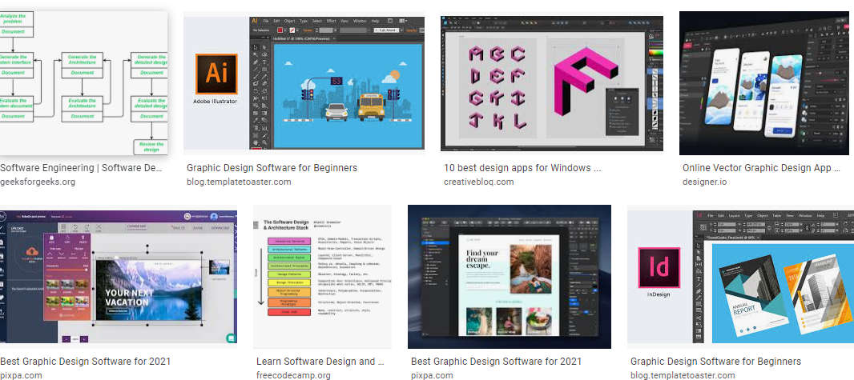

Slide 3
Software Design
According to the IEEE definition [IEEE 610.12-90], design is both “the process of defining the architecture, components, interfaces, and other characteristics of a system or component” and “the result of [that] process.” The KA is divided into six subareas.

Slide 4
Topics covered
Data Models ( data base)
User Interface Models
Object Oriented Concepts (UML Modeling)

Slide 5
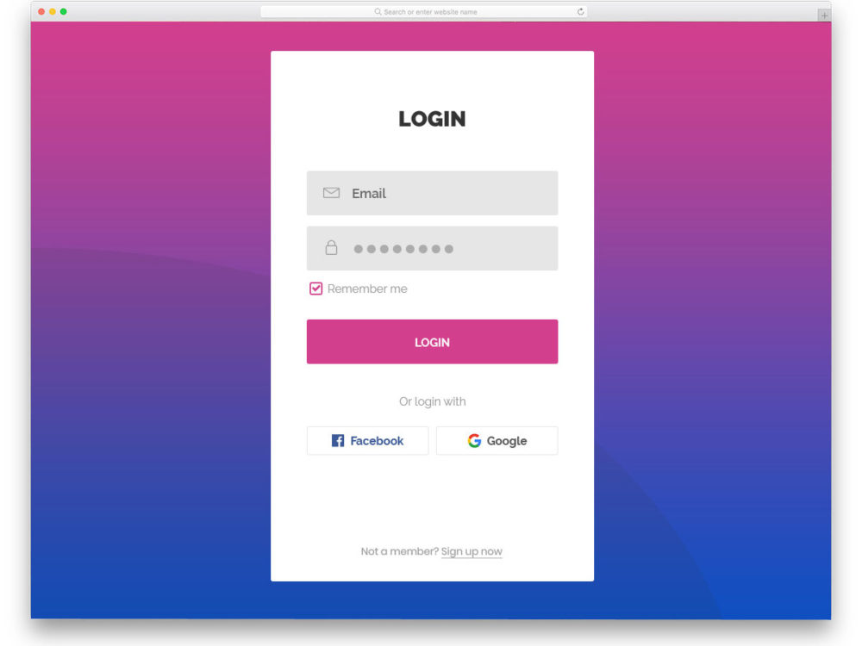
CS Student to Agile [ Not all, few curious minds]
Why design, why not coding ?

Slide 6
CS Student to Agile [ Not all, few curious minds]
Why design, why not coding ?

Slide 7

CS Student to Agile [ Not all, few curious minds]
Why design, why not coding ?

Slide 8
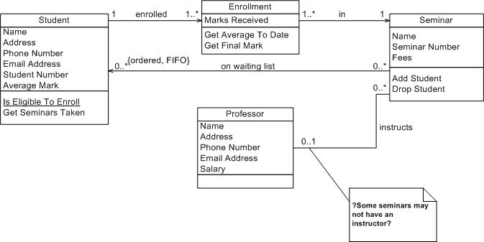
CS Student to Agile [ Not all, few curious minds]
Why design, why not coding ?

Slide 9

CS Student to Agile [ Not all, few curious minds]
Why design, why not coding ?

Slide 11
Topics: Software Design
Context models (Soft Architecture)
Interaction models
Structural models
Behavioral models
Model-driven engineering

Slide 12



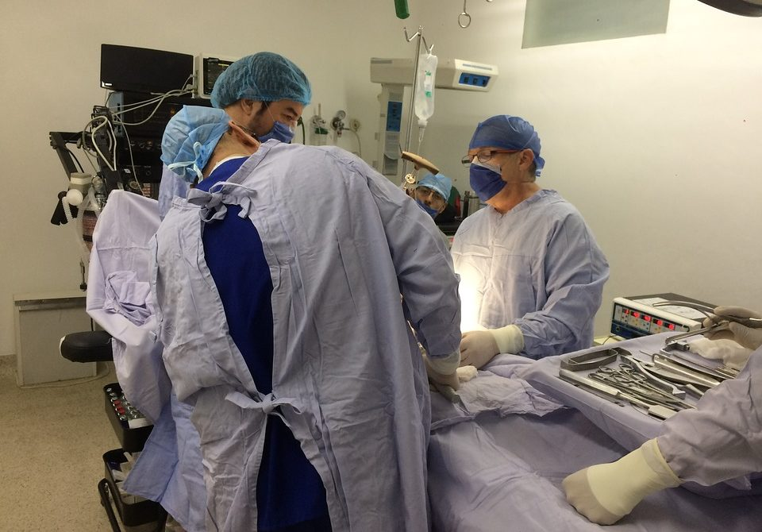


Case Study: Hospital Management
All reference to Google images

Slide 13
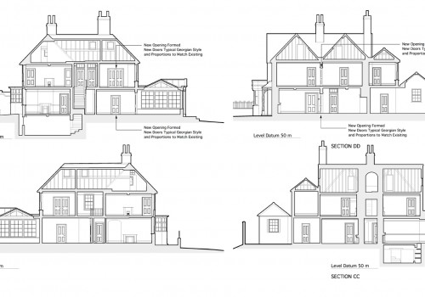
Case Study: House Construction

Slide 14
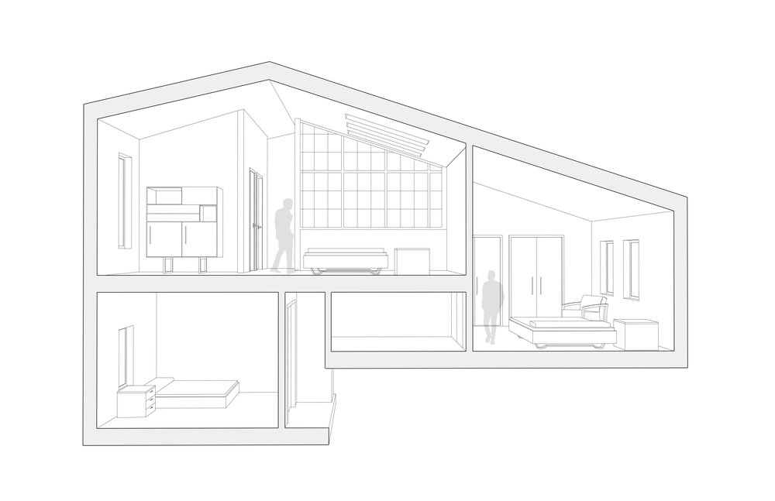
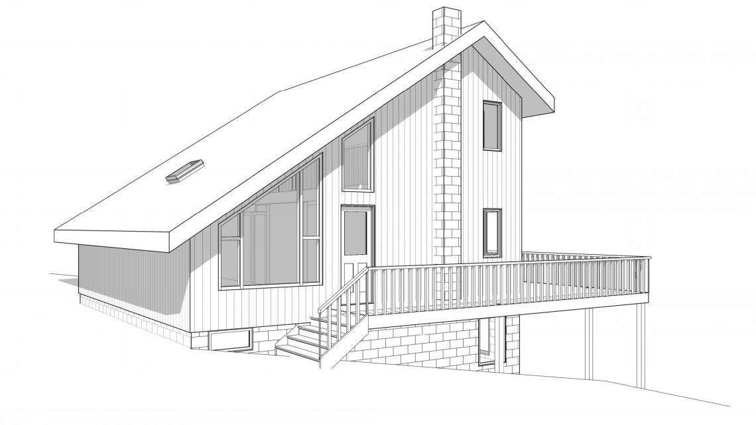
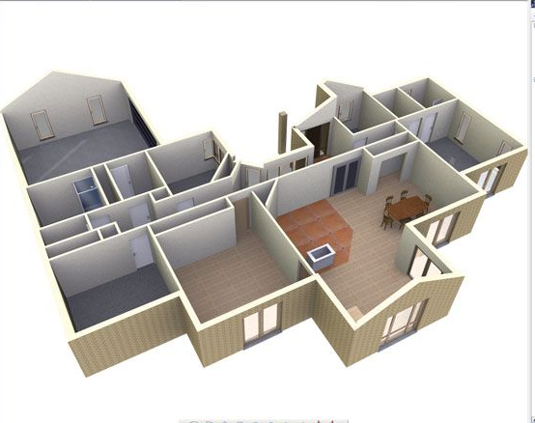
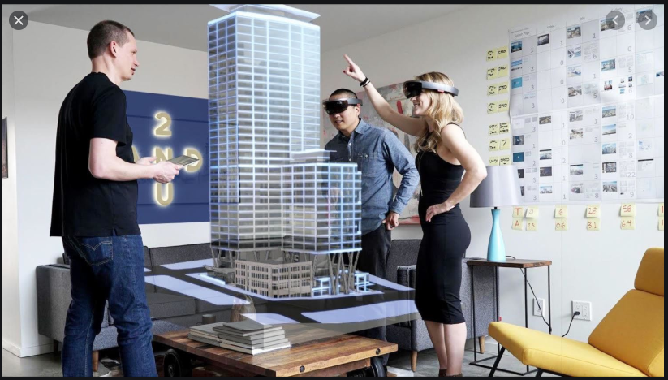
Case Study: House Environment

Slide 15
Topics covered
Context models
Interaction models
Structural models
Behavioral models
Model-driven engineering

Slide 16
System modeling
System modeling is the process of developing abstract models of a system, with each model presenting a different view or perspective of that system.
System modeling representing a system using some kind of graphical notation, which is now almost always based on notations in the Unified Modeling Language (UML).
System modelling helps the analyst to understand the functionality of the system and models are used to communicate with customers.

Slide 17
Software Design
Encompasses the set of principles, concepts, and practices that lead to the development of a high-quality system or product.
Design principles establish and overriding philosophy that guides the designer as the work is performed.
Design concepts must be understood before the mechanics of design practice are applied.
Software design practices change continuously as new methods, better analysis, and broader understanding evolve.

Slide 18
Existing and planned system models
Models of the existing system are used during requirements engineering. They help clarify what the existing system does and can be used as a basis for discussing its strengths and weaknesses. These then lead to requirements for the new system.
Models of the new system are used during requirements engineering to help explain the proposed requirements to other system stakeholders(example prototypes). Engineers use these models to discuss design proposals and to document the system for implementation.
In a model-driven engineering process, it is possible to generate a complete or partial system implementation from the system model.

Slide 19
System perspectives
An external perspective, where you model the context or environment of the system.
An interaction perspective, where you model the interactions between a system and its environment, or between the components of a system.
A structural perspective, where you model the organization of a system or the structure of the data that is processed by the system.
A behavioral perspective, where you model the dynamic behavior of the system and how it responds to events.

Slide 20
Software Engineering Design
Data/Class design – transforms analysis classes into implementation classes and data structures.
Architectural design – defines relationships among the major software structural elements.
Interface design – defines how software elements, hardware elements, and end-users communicate.
Component-level design – transforms structural elements into procedural descriptions of software components.

Slide 21
UML diagram types
Activity diagrams, which show the activities involved in a process or in data processing .
Use case diagrams, which show the interactions between a system and its environment.
Sequence diagrams, which show interactions between actors and the system and between system components.
Class diagrams, which show the object classes in the system and the associations between these classes.
State diagrams, which show how the system reacts to internal and external events.

Slide 22
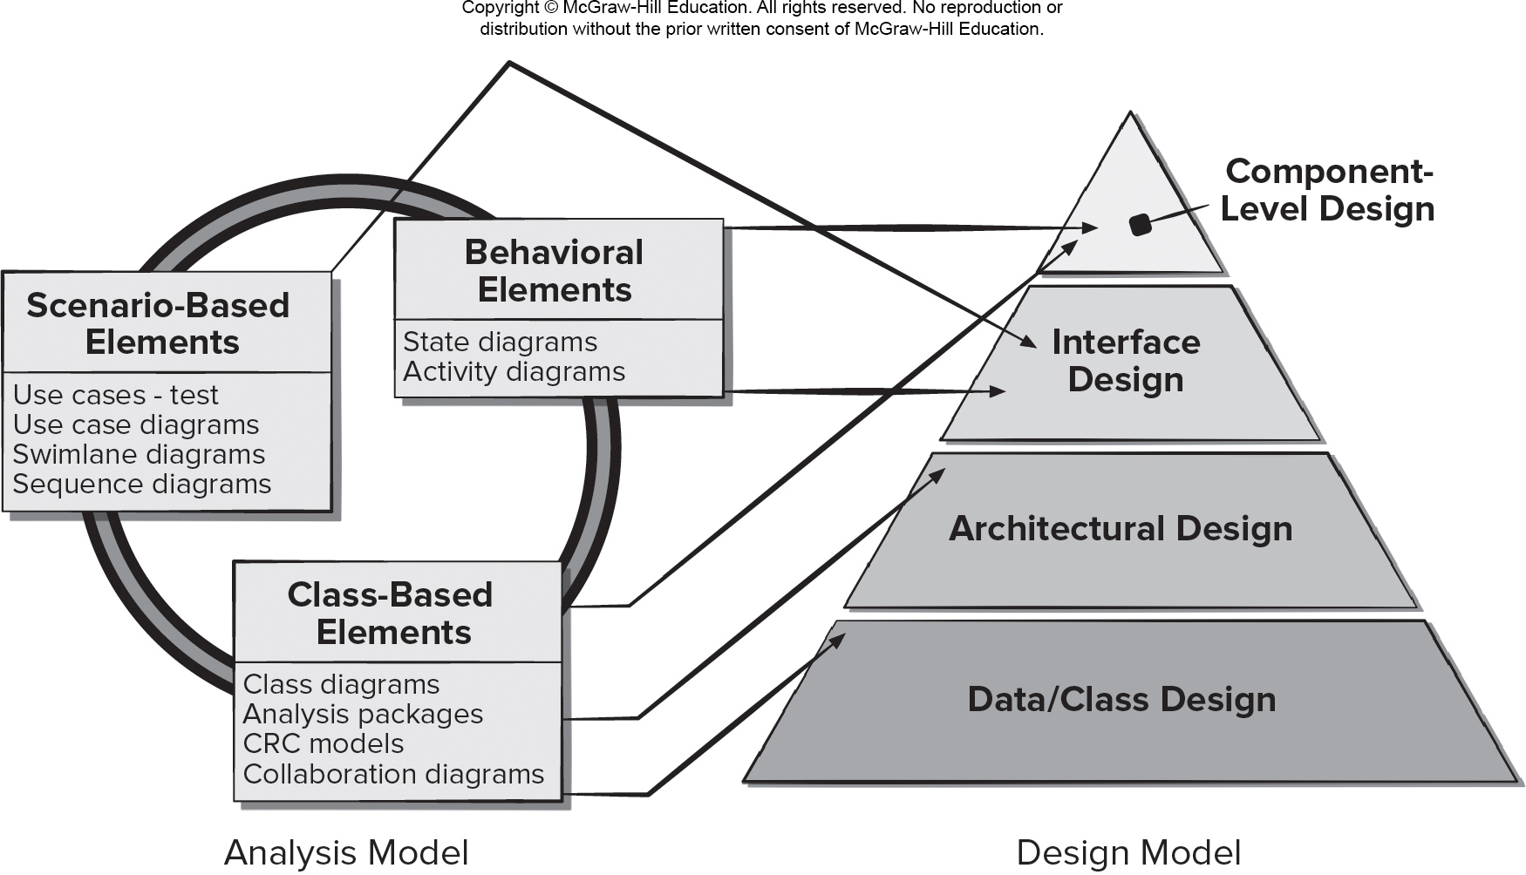
Mapping Requirements Model to Design Model
Access the text alternative for slide images.

Slide 23
Common Design Characteristics
Each new software design methodology introduces unique heuristics and notions – yet they each contain:
A mechanism for the translating the requirements model into a design representation.
A notation for representing functional components and their interfaces.
Heuristics for Refinement and Partitioning.
Guidelines for Quality Assessment.

Slide 24
Design Concepts 1
Abstraction – data (named collection of data describing data object), procedural (name sequence of instructions with specific and limited function).
Architecture - overall structure or organization of software components, ways components interact, and structure of data used by components.
Design Patterns - describe a design structure that solves a well-defined design problem within a specific context.
Separation of concerns - any complex problem can be more easily handled if it is subdivided into pieces.
Modularity—compartmentalization of data and function.

Slide 25
Use of graphical models
As a means of facilitating discussion about an existing or proposed system
Incomplete and incorrect models are OK as their role is to support discussion.
As a way of documenting an existing system
Models should be an accurate representation of the system but need not be complete.
As a detailed system description that can be used to generate a system implementation
Models have to be both correct and complete.

Slide 26
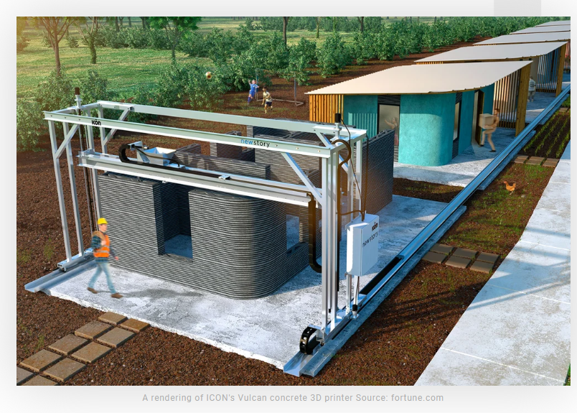

Slide 27
Context models

Slide 28
Context models
Context models are used to illustrate the operational context of a system - they show what lies outside the system boundaries.
Social and organisational concerns may affect the decision on where to position system boundaries.
Architectural models show the system and its relationship with other systems.

Slide 29
The context of the Mentcare system

Slide 30
Process perspective
Context models simply show the other systems in the environment, not how the system being developed is used in that environment.
Process models reveal how the system being developed is used in broader business processes.
UML activity diagrams may be used to define business process models.

Slide 31
Process model of involuntary detention

Slide 32
Interaction models

Slide 33
Interaction models
Modeling user interaction is important as it helps to identify user requirements.
Modeling system-to-system interaction highlights the communication problems that may arise.
Modeling component interaction helps us understand if a proposed system structure is likely to deliver the required system performance and dependability.
Use case diagrams and sequence diagrams may/can be used for interaction modeling.

Slide 34
Use case modeling
Use cases were developed originally to support requirements elicitation and now incorporated into the UML.
Each use case represents a discrete task that involves external interaction with a system.
Actors in a use case may be people or other systems.
Represented diagramatically to provide an overview of the use case and in a more detailed textual form.

Slide 35
Transfer-data use case
A use case in the Mentcare system

Slide 36
Use cases in the Mentcare system involving the role ‘Medical Receptionist’

Slide 37
Tabular description of the ‘Transfer data’ use-case
MHC-PMS: Transfer data
Actors | Medical receptionist, patient records system (PRS)
Description | A receptionist may transfer data from the Mentcase system to a general patient record database that is maintained by a health authority. The information transferred may either be updated personal information (address, phone number, etc.) or a summary of the patient’s diagnosis and treatment.
Data | Patient’s personal information, treatment summary
Stimulus | User command issued by medical receptionist
Response | Confirmation that PRS has been updated
Comments | The receptionist must have appropriate security permissions to access the patient information and the PRS.

Slide 38
Sequence diagrams
Sequence diagrams are part of the UML and are used to model the interactions between the actors and the objects within a system.
A sequence diagram shows the sequence of interactions that take place during a particular use case or use case instance.
The objects and actors involved are listed along the top of the diagram, with a dotted line drawn vertically from these.
Interactions between objects are indicated by annotated arrows.

Slide 39
Sequence diagram for View patient information

Slide 40
Sequence diagram for Transfer Data

Slide 41
Structural models

Slide 42
Structural models
Structural models of software display the organization of a system in terms of the components that make up that system and their relationships.
Structural models may be static models, which show the structure of the system design, or dynamic models, which show the organization of the system when it is executing.
You create structural models of a system when you are discussing and designing the system architecture.

Slide 43
Class diagrams
Class diagrams are used when developing an object-oriented system model to show the classes in a system and the associations between these classes.
An object class can be thought of as a general definition of one kind of system object.
An association is a link between classes that indicates that there is some relationship between these classes.
When you are developing models during the early stages of the software engineering process, objects represent something in the real world, such as a patient, a prescription, doctor, etc.

Slide 44
Classes and associations in the MHC-PMS

Slide 45
The Consultation class

Slide 46
Event-driven modeling
Real-time systems are often event-driven, with minimal data processing. For example, a landline phone switching system responds to events such as ‘receiver off hook’ by generating a dial tone.
Event-driven modeling shows how a system responds to external and internal events.
It is based on the assumption that a system has a finite number of states and that events (stimuli) may cause a transition from one state to another.

Slide 47
State diagram of a microwave oven

